Slide 1
ELBRIT SALES ANALYSIS

Slide 2
Insights
The Highest selling product in September is NEURONZ D with a percentage of 5.55 %.
The product which has the highest sales for the “CND – Chennai” sales team in May is NEURONZ D with 21.73 %.
RSM PHARMA PVT LTD had the maximum stock returns in October for Bangalore HQ.
CND Coimbatore sales team had the maximum percentage of primary sales returned due to expiry.
0.26 % is the overall percentage of sales that was affected due to breakage.
The primary sales for the Delhi HQ in the month of September is
North Delhi – 11.18 %
South Delhi – 11.81 %
East Delhi – 7.68 %
West Delhi – 18.32 %
The sales of “BRITORVA 20” in September for PALEPU PHARMA DIST PVT LTD is 4637 quantities.

Slide 3
FORCASTED INSIGHTS FOR OCTOBER AND NOVEMBER
The forecasted value for primary sales in the month of October is 72.87 K.
NEURONZ D has the highest forecasted sales for the “CND CHENNAI” sales team in November.
8,53,257 is the forecasted value of “BRITORVA 20” in October under Coimbatore HQ.

Slide 4
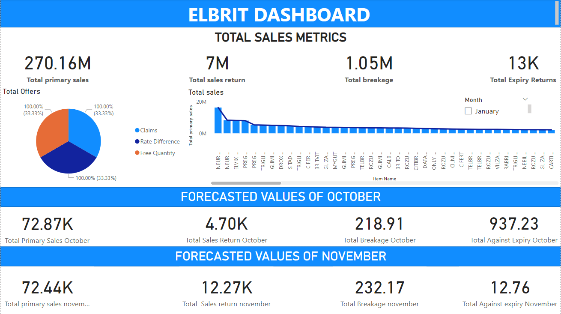
ELBRIT SALES DASHBOARD

